Slide 1













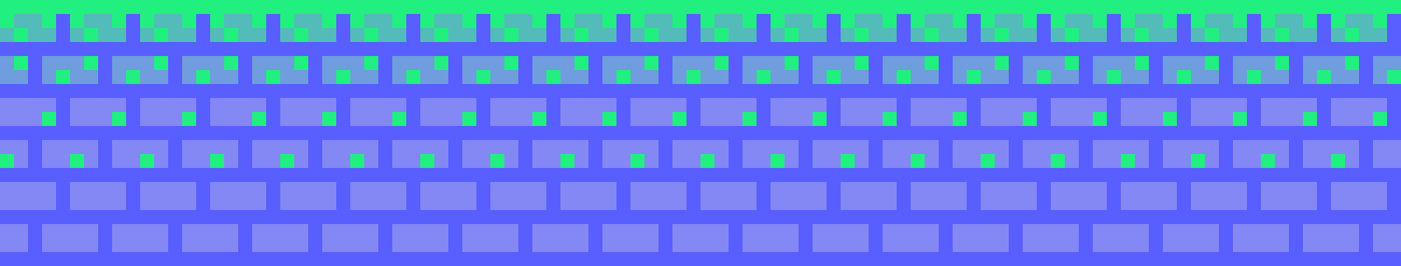
PLAYER 1
HIGHSCORE 9000
PLAYER 2
LEVELING UP GHIDRA:
LEARN GHIDRA PLUGINS WITH A GAME BOY GAME
Bsides Colorado Springs- September 14th, 2024
JACOB LATONIS

Slide 2











01
07
12
WHOAMI
Name: Jacob Latonis
What I do: Staff Software Engineer, Threat Research @ proofpoint
Residing in: Boulder, CO
What i do for fun: running, reading, hiking, open-source development

Slide 3





01
07
12
PLUGINS?
GHIDRA ECOSYSTEM
POSSIBILITIES
WRITING THE PLUGIN
A LOT MORE!
AGENDA
GHIDRA
The possibilities!
Implementation
A lot more!

Slide 4
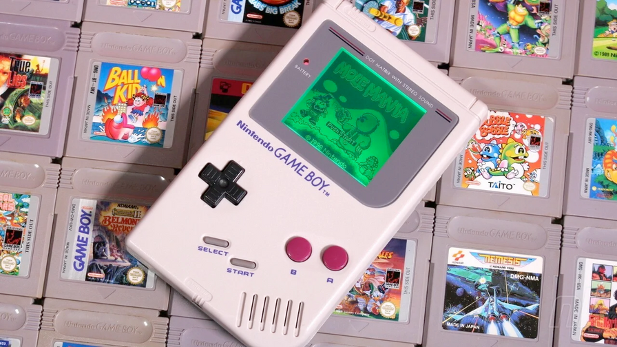

01
07
12
BEFORE WE START...
We will discuss a whole lot here today, not every topic will have the time and/or focus to be fully completed and discussed.
curious on what a full plugin implementation and design looks like? I have published a fully working plugin on github under the APACHE 2.0 license.

Slide 5











INTRODUCTION

Slide 6
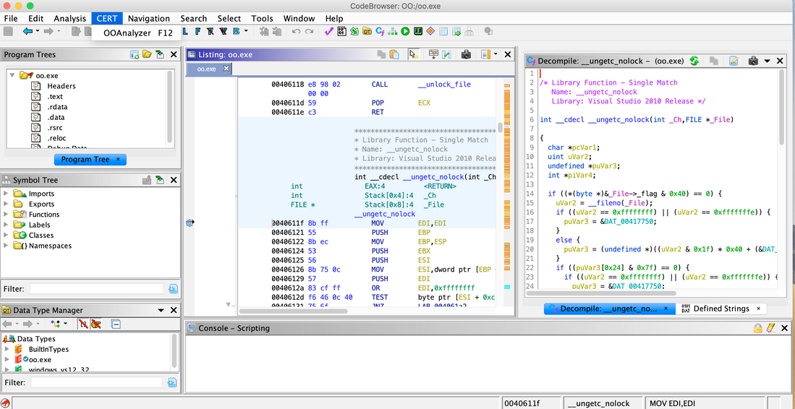
01
07
12
GHIDRA!
Open-Source Reverse engineering Toolkit
Developed by the NSA because IDA costs a billion dollars
Highly extensible and customizable
FREE!

Slide 7
GETTING STARTED

Slide 8

Automations
Java
Ghidra Architecture
Python (Jython)
Scripting
There’s quite a few moving parts in Ghidra itself, even before we start adding stuff.
GHIDRA
Plugins
Exports
Components
Core Platform
Actions
Flat API
Extensible Components
Decompiler

Slide 9
SCRIPTING AND PLUGINS

Slide 10

01
07
12
SCRIPTING
IN
GHIDRA
Written in Python (Jython) or JAva
Access to the FLATAPI and more
Can be ran from CLI or Action

Slide 11

01
07
12
PLUGINS
IN
GHIDRA
Written in JAVA
Allows for more in-Depth Use than Scripting (keep state, GUI, etc)
Can be built and distributed, instead of a script

Slide 12
GAME BOY?

Slide 13
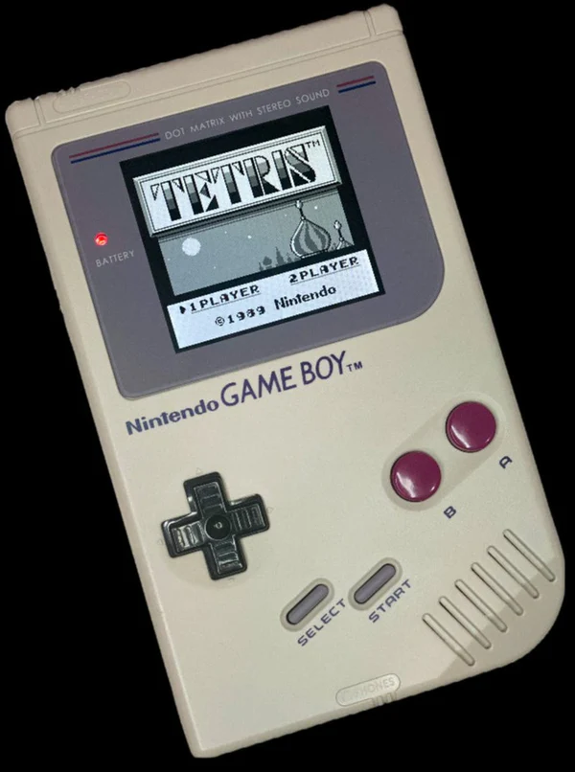
GAME BOY!
Developed by Nintendo
Originally released in 1989
lots, and lots, of games to play, games still being developed in indie scene
still used for leisure and competitive play world wide

Slide 14
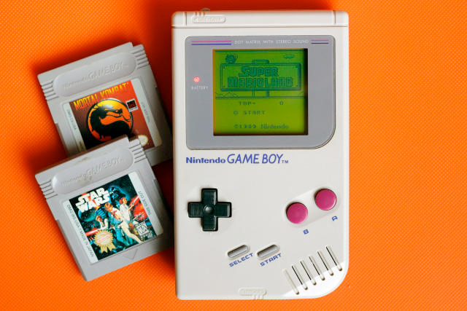
01
07
12
small, handheld video games (lots)
8-bit CPU similar to 8080 SHARP CPU
4.194304 MHz CPU | 160 x 144 Display

Slide 15
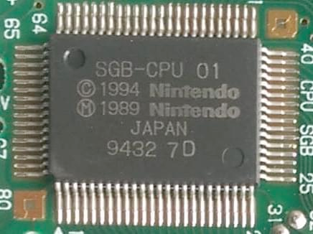
GAME BOY RESOURCES
GEKKIO/GB-RESEARCH
GAME BOY PANDOCS
GEKKIO/GHIDRABOY
GEKKIO/GB-CTR
(COMPLETE TECHNICAL REFERENCE)

Slide 16
01
07
12
GAME BOY CARTRIDGE
0100-0103 — ENTRY POINT
0104-0133 — NINTENDO LOGO
0134-0143 — TITLE
013F-0142 — MANUFACTURER CODE
0143 — CGB FLAG
0144–0145 — NEW LICENSEE CODE
0146 — SGB FLAG
0147 — CARTRIDGE TYPE
0148 — ROM SIZE
0149 — RAM SIZE
014A — DESTINATION CODE
014B — OLD LICENSEE CODE
014C — MASK ROM VERSION NUMBER
014D — HEADER CHECKSUM
014E-014F — GLOBAL CHECKSUM
Each cartridge has a header
Header contains information about the game
We want that information; how do we get it?

Slide 17
01
07
12
HEADER BROKEN DOWN!
0100-0103 — ENTRY POINT
0104-0133 — NINTENDO LOGO
0134-0143 — TITLE
013F-0142 — MANUFACTURER CODE
Notes:
After displaying the Nintendo logo, the built-in boot ROM jumps to the address $0100, which should then jump to the actual main program in the cartridge. Most commercial games fill this 4-byte area with a nop instruction followed by a jp $0150.
This area contains a bitmap image that is displayed when the Game Boy is powered on. It must match the following (hexadecimal) dump, otherwise the boot ROM won’t allow the game to run:
These bytes contain the title of the game in upper case ASCII. If the title is less than 16 characters long, the remaining bytes should be padded with $00s.
Parts of this area actually have a different meaning on later cartridges, reducing the actual title size to 15 ($0134–$0142) or 11 ($0134–$013E) characters; see below.
In older cartridges these bytes were part of the Title (see above). In newer cartridges they contain a 4-character manufacturer code (in uppercase ASCII). The purpose of the manufacturer code is unknown.

Slide 18
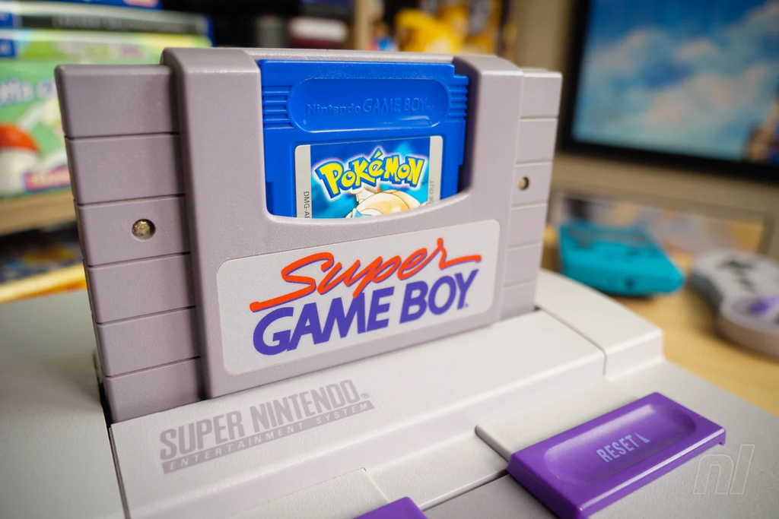
01
07
12
HEADER BROKEN DOWN!
0143 — CGB FLAG
0144–0145 — NEW LICENSEE CODE
0146 — SGB FLAG
0147 — CARTRIDGE TYPE
Notes:
In older cartridges this byte was part of the Title (see above). The CGB and later models interpret this byte to decide whether to enable Color mode (“CGB Mode”) or to fall back to monochrome compatibility mode (“Non-CGB Mode”).
This area contains a two-character ASCII “licensee code” indicating the game’s publisher. It is only meaningful if the Old licensee is exactly $33 (which is the case for essentially all games made after the SGB was released); otherwise, the old code must be considered.
The Super Game Boy is a peripheral that allows Game Boy cartridges to be played on a Super Nintendo Entertainment System console.
This byte indicates what kind of hardware is present on the cartridge — most notably its mapper.

Slide 19
01
07
12
HEADER BROKEN DOWN!
0148 — ROM SIZE
0149 — RAM SIZE
014A — DESTINATION CODE
014B — OLD LICENSEE CODE
Notes:
This byte indicates how much ROM is present on the cartridge. In most cases, the ROM size is given by 32 KiB × (1 << <value>):
This byte indicates how much RAM is present on the cartridge, if any.
If the cartridge type does not include “RAM” in its name, this should be set to 0. This includes MBC2, since its 512 × 4 bits of memory are built directly into the mapper.
This byte specifies whether this version of the game is intended to be sold in Japan or elsewhere.
This byte is used in older (pre-SGB) cartridges to specify the game’s publisher. However, the value $33 indicates that the New licensee codes must be considered instead. (The SGB will ignore any command packets unless this value is $33.)

Slide 20
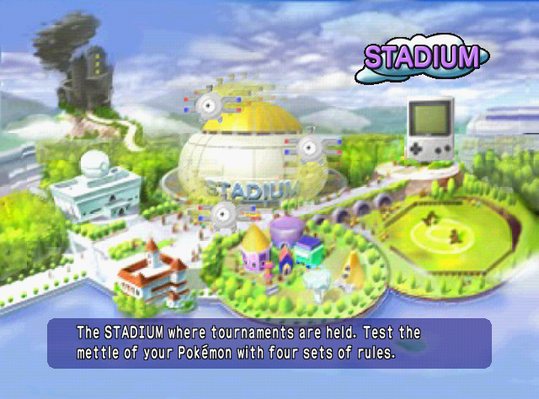
01
07
12
HEADER BROKEN DOWN!
014C — MASK ROM VERSION NUMBER
014D — HEADER CHECKSUM
014E-014F — GLOBAL CHECKSUM
Notes:
This byte specifies the version number of the game. It is usually $00.
This byte contains an 8-bit checksum computed from the cartridge header bytes $0134–014C. The boot ROM computes the checksum as follows:
uint8_t checksum = 0;
for (uint16_t address = 0x0134; address <= 0x014C; address++) {
checksum = checksum - rom[address] - 1;
}
The boot ROM verifies this checksum. If the byte at $014D does not match the lower 8 bits of checksum, the boot ROM will lock up and the program in the cartridge won’t run.
These bytes contain a 16-bit (big-endian) checksum simply computed as the sum of all the bytes of the cartridge ROM (except these two checksum bytes).
This checksum is not verified, except by Pokémon Stadium’s “GB Tower” emulator (presumably to detect Transfer Pak errors).

Slide 21

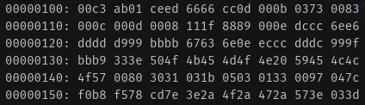
01
07
12
WHO’S THAT POKEMON?

Slide 22
01
07
12
WRITE A PARSER?
EACH CARTRIDGE CONTAINS A HEADER, LOCATED AT THE ADDRESS RANGE
$0100—$014F.
THE CARTRIDGE HEADER PROVIDES INFORMATION ABOUT THE GAME ITSELF AND THE HARDWARE IT EXPECTS TO RUN ON.
Cartridge header has the info we want; time to parse byte by byte.

Slide 23
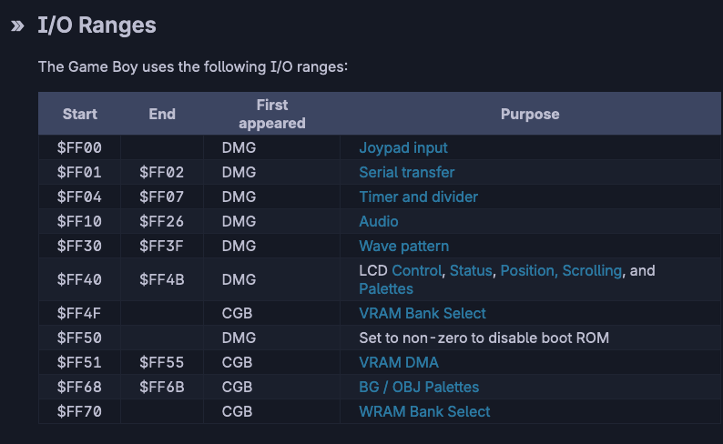
01
07
12
Custom CPU/Instruction Set
Lots of I/O and Addressing to Get FAMILIAR WITH

Slide 24
PLUGIN DEEP DIVE

Slide 25


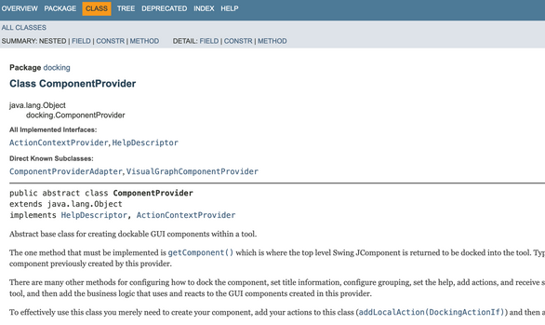
Whole lot of Java
Unlike scripting which can be written in Java or Python (Jython), plugins for Ghidra are written in Java
WRITING A PLUGIN: WHAT DO WE NEED?
A bit of Gradle
Gradle is the build system that is used for building Ghidra plugins ready for distribution.
Many Patience to read many docs
The docs for/in Ghidra can get pretty elaborate.

Slide 26
WRITING THE PLUGIN

Slide 27
01
07
12
EXAMPLES!
Ghidra provides quite a few examples for us
Plugin examples
Scripting examples
located in <ghidra_dir>/Extensions/Ghidra/

Slide 28

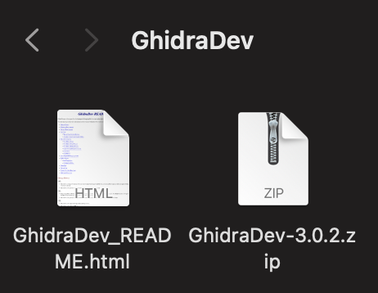
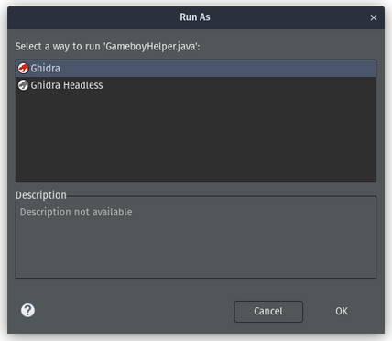
TEAM ECLIPSE
If you want the nice helper utilities for Ghidra development, welcome to Eclipse. It’s only a lot more painful than IntelliJ IDEA.
WRITING THE PLUGIN
USE GHIDRADEV
The GhidraDev extension for eclipse generates skeleton files, allowing us to start quickly!
Debugging is a go
The GhidraDev extension for Eclipse allows us to run and debug the plugin between changes.

Slide 29
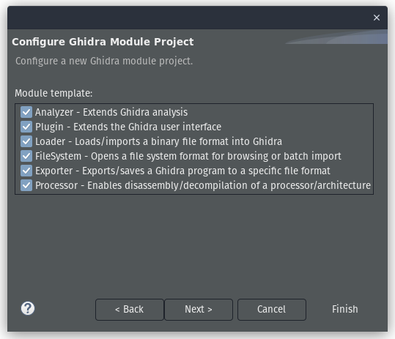
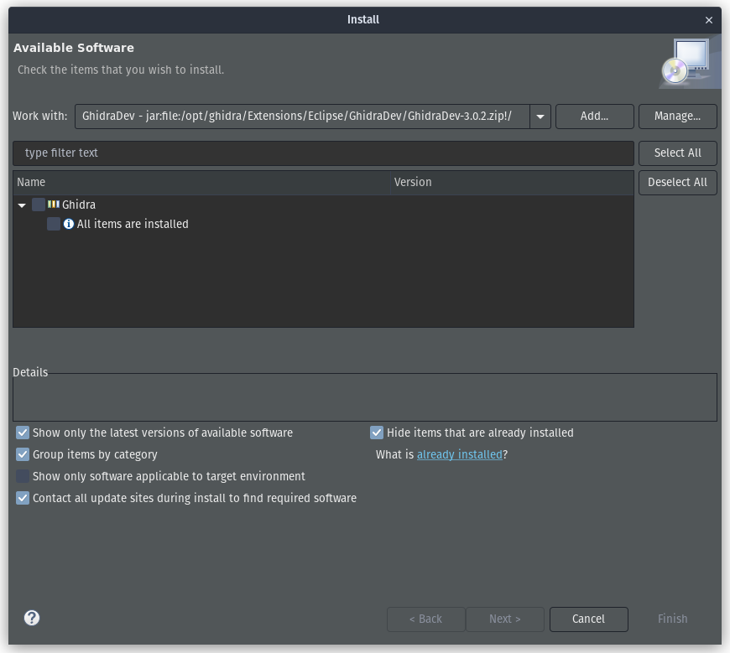
01
07
12
LEVERAGING GHIDRADEV
located in <ghidra_dir>/Extensions/Eclipse/GhidraDev/

Slide 30
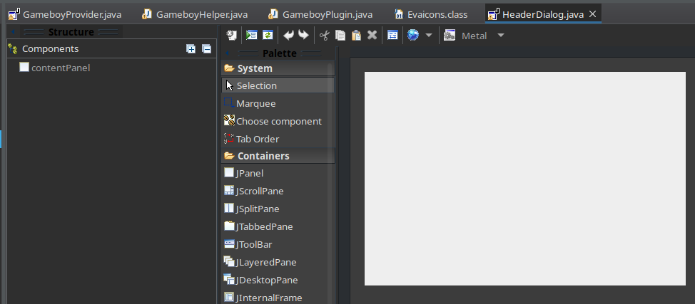
01
07
12
WORKING WITH UI STUFF
WindowBuilder!

Slide 31
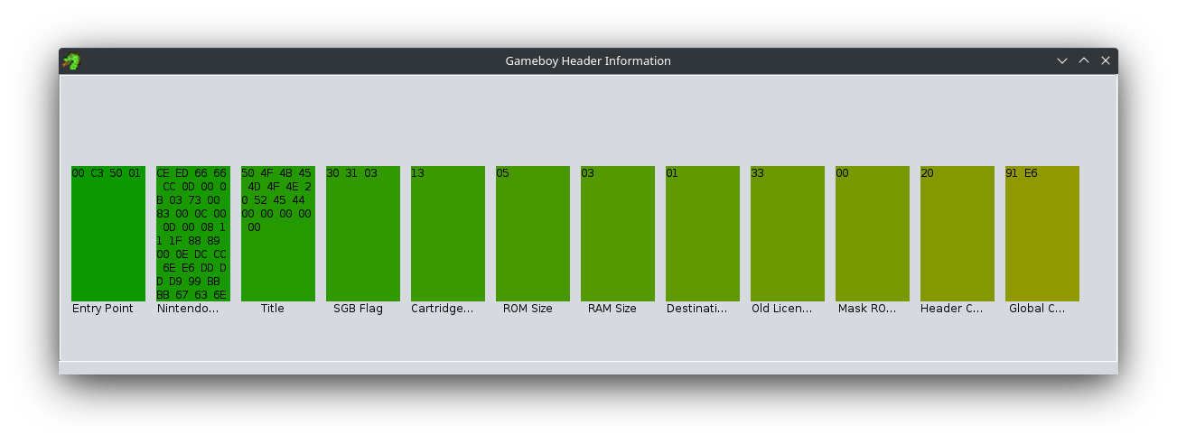
01
07
12
MY FIRST UI ATTEMPT

Slide 32
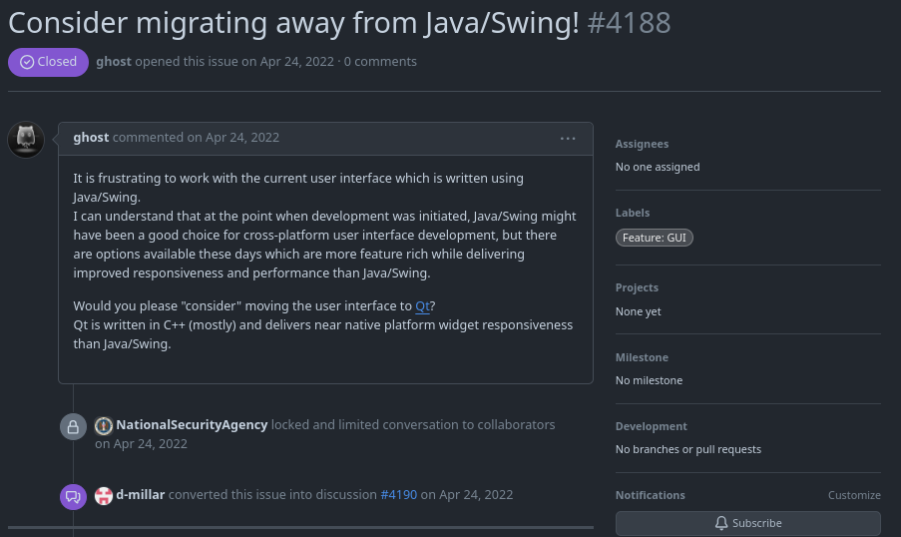
01
07
12
FRUSTRATION?

Slide 33

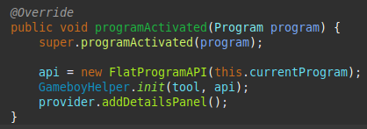
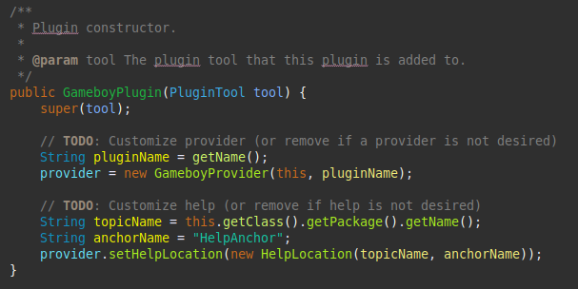
HIGHSCORE 2500
PLAYER 2
PLUGIN COMPONENT
This is where you define the plugin to Ghidra
Allows you to initialize things

Slide 34
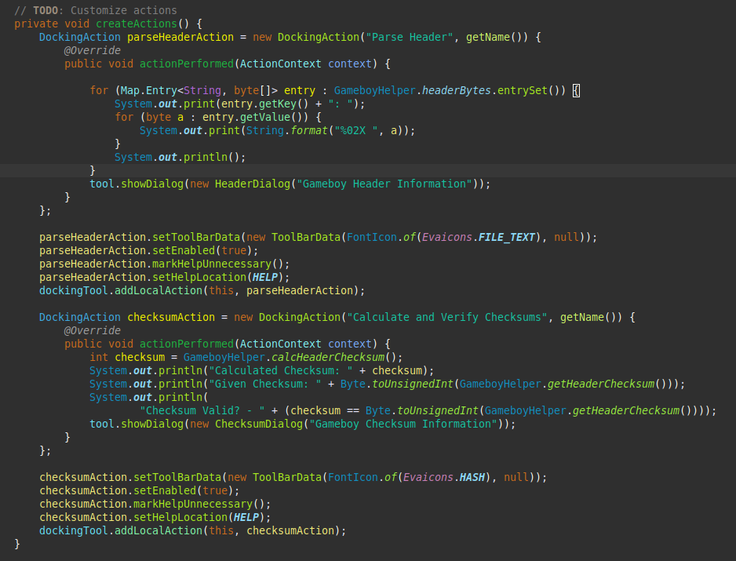
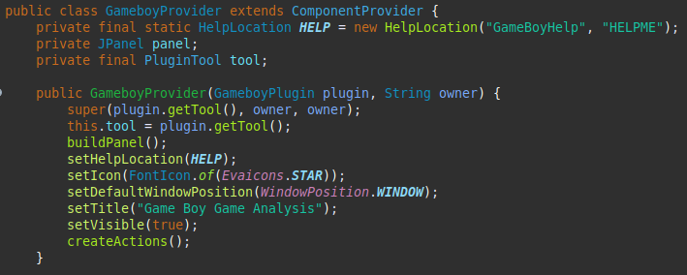
HIGHSCORE 2500
PLAYER 2
PROVIDER COMPONENT
This is where you define the layout, the GUI, that sort of stuff.
You initialize actions and callbacks here as well.

Slide 35
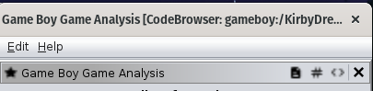

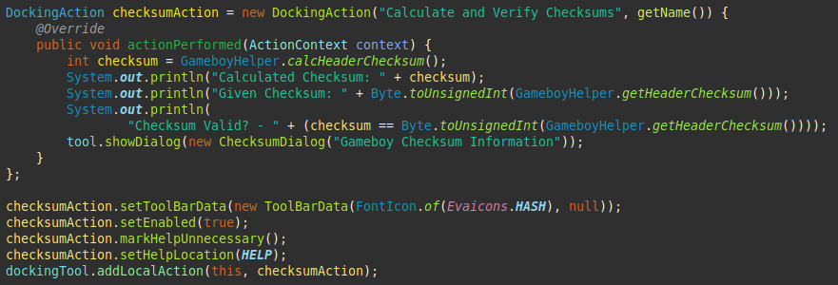
HIGHSCORE 2500
PLAYER 2
DOCKING ACTIONS
Actions that fire when a trigger occurs (button click, state change, etc)
small functions that can call other things or behavior

Slide 36
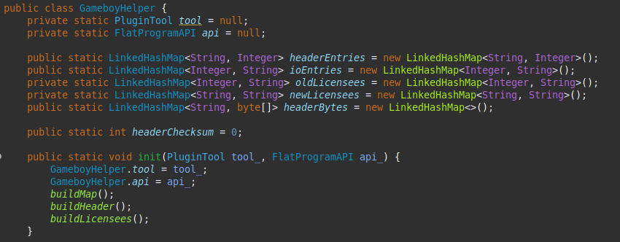
HIGHSCORE 2500
PLAYER 2
HELPER COMPONENT
Helper component lets you abstract things
Keep state, perform calculations, etc
Leverage it to make things simpler and repeatable

Slide 37
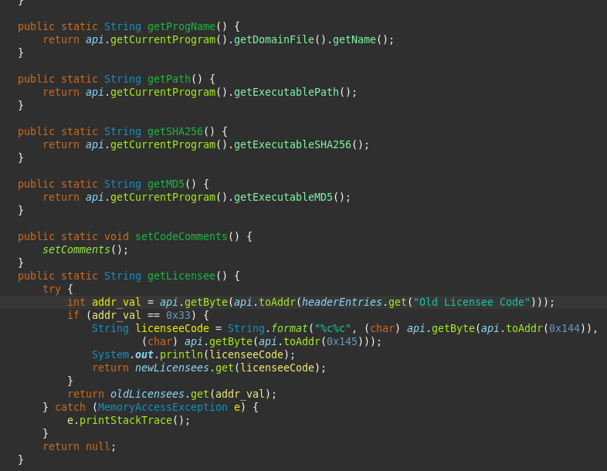
HIGHSCORE 2500
PLAYER 2
MAKES THINGS SIMPLER

Slide 38
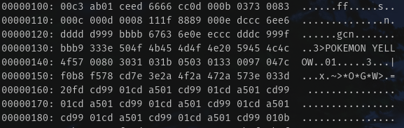
01
07
12
REMEMBER THAT PARSER WE NEEDED?
Earlier we discovered we needed to parse the cartridge header. Let’s Parse it.

Slide 39
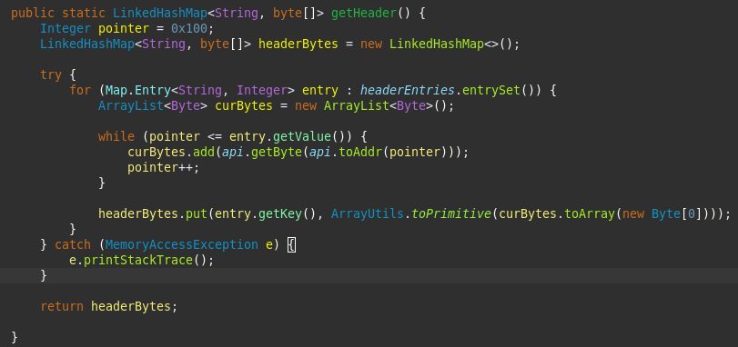
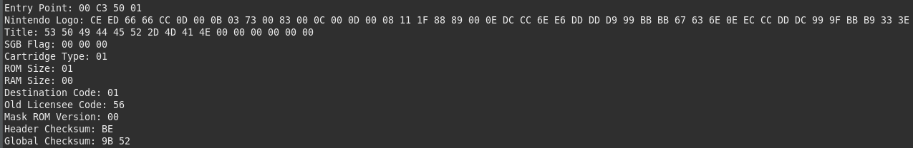
01
07
12
PARSE IT
FLATapi.getByte(FLATapI.toAddr(ADDR_POINTER))

Slide 40
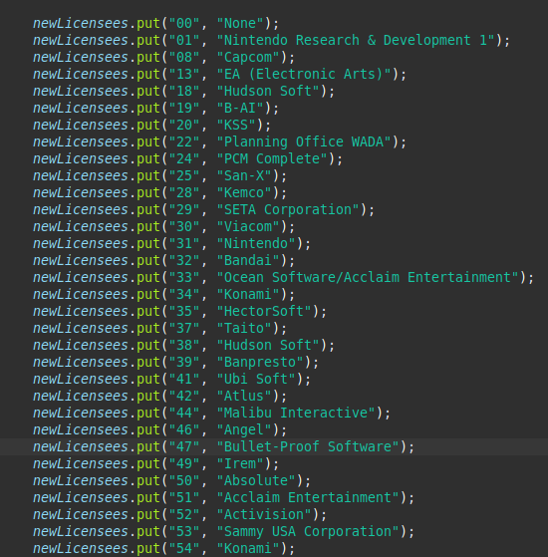
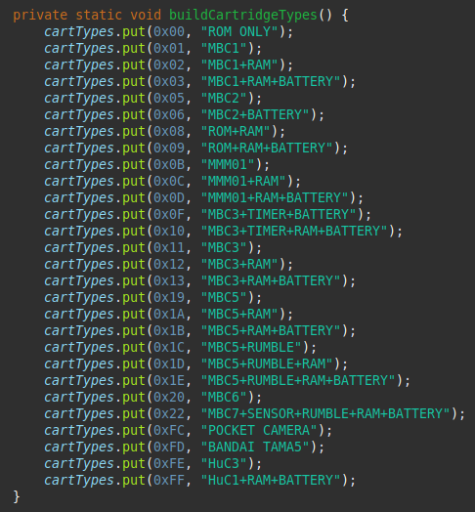
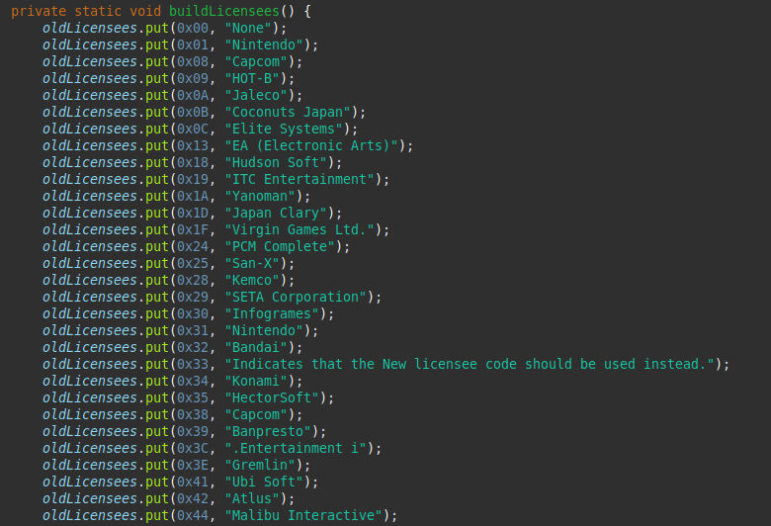
01
07
12
CONVERTING THE BYTES TO INFORMATION

Slide 41
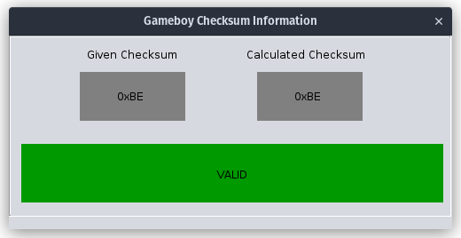
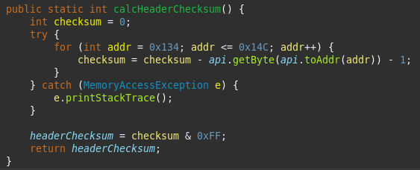
01
07
12
VERIFYING HEADER INFO
Luckily, if we parse correctly, we can verify it with a checksum.

Slide 42
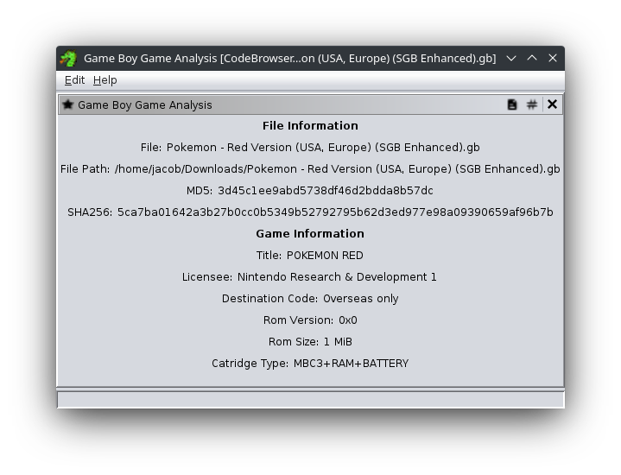
01
07
12
GOOD INFO? GOOD!
As we know if we parsed things correctly, we can now display it to the user for quick info.

Slide 43


01
07
12
WHO KNOWS TETRIS?

Slide 44
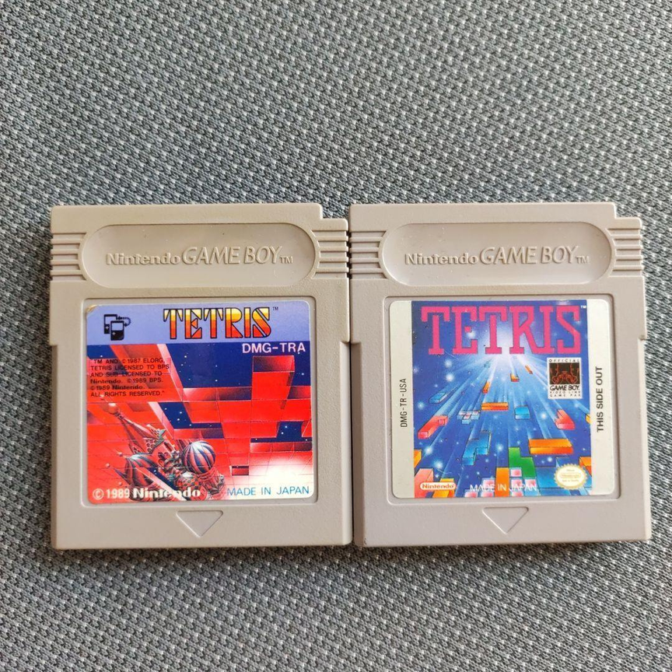
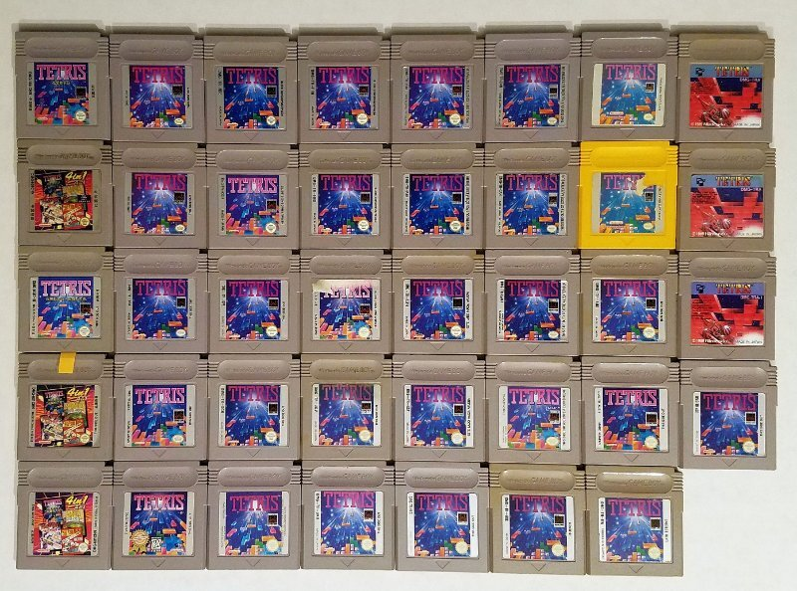
01
07
12
VARIOUS VERSIONS OF TETRIS

Slide 45
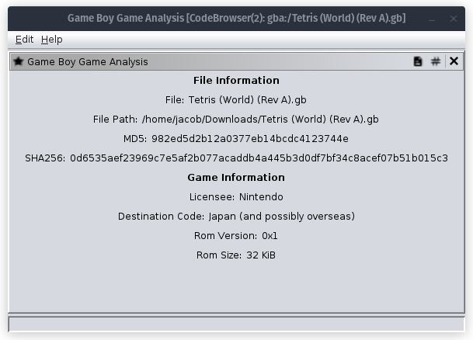
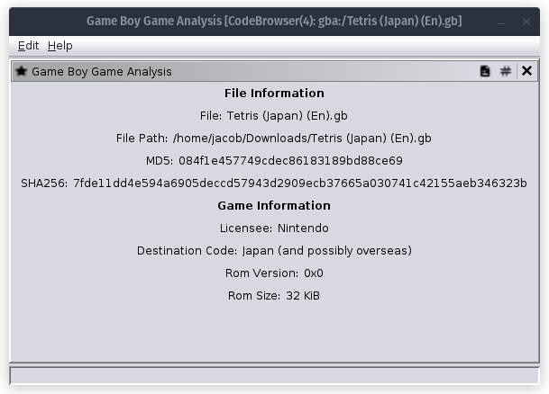
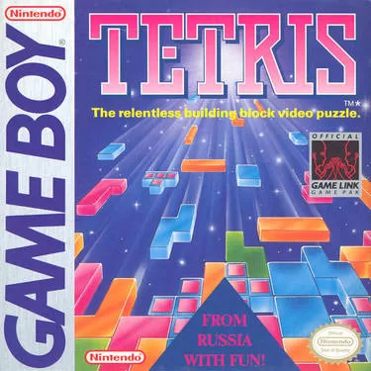
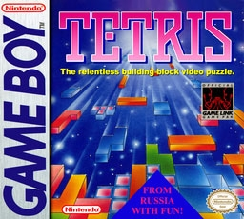
01
07
12
VARIOUS VERSIONS OF TETRIS

Slide 46
NEXT USE CASE: I/O

Slide 47
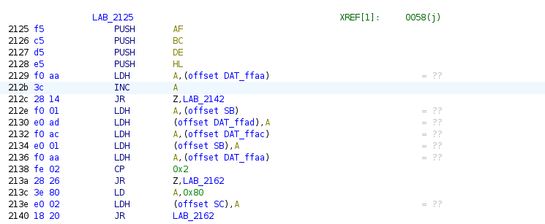
01
07
12
GOING FROM THIS ...
A bit ago, I showed the hardware address table, let’s use that context!

Slide 48
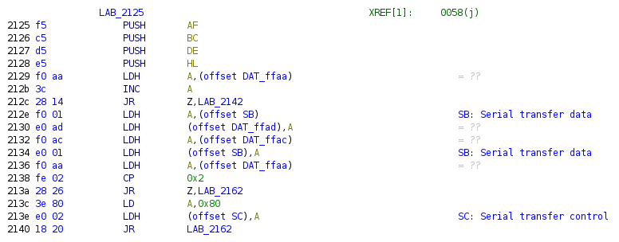
01
07
12
TO THIS ...
SHowing Hardware (I/O)
Addresses!

Slide 49
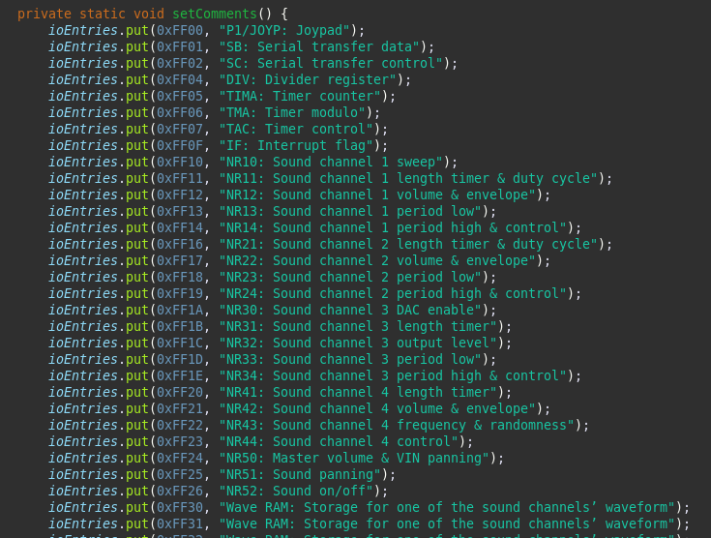
01
07
12
MAP INSTRUCTIONS TO HARDWARE

Slide 50
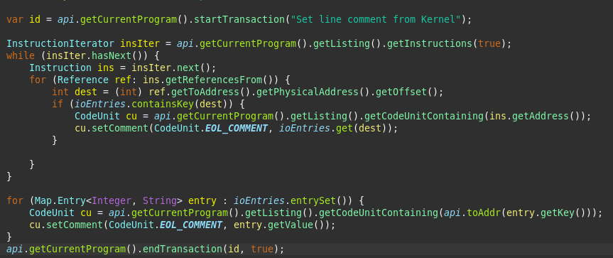
01
07
12
MAP INSTRUCTIONS TO HARDWARE

Slide 51
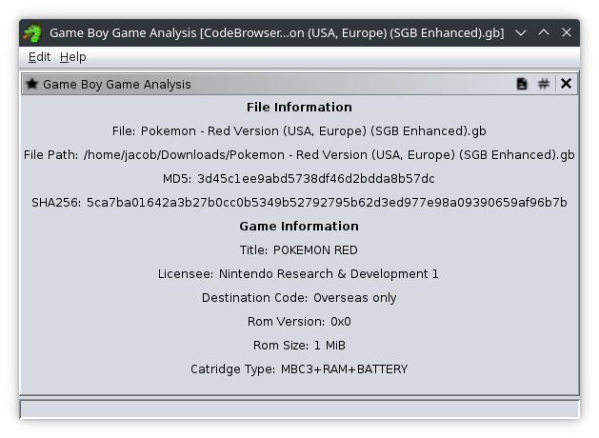
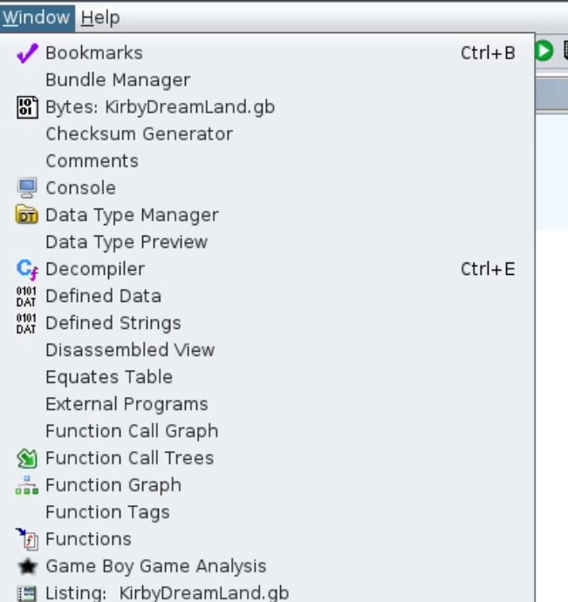
01
07
12
FINISHED (?) PRODUCT!

Slide 52
01
07
12
POKEMON!

Slide 53
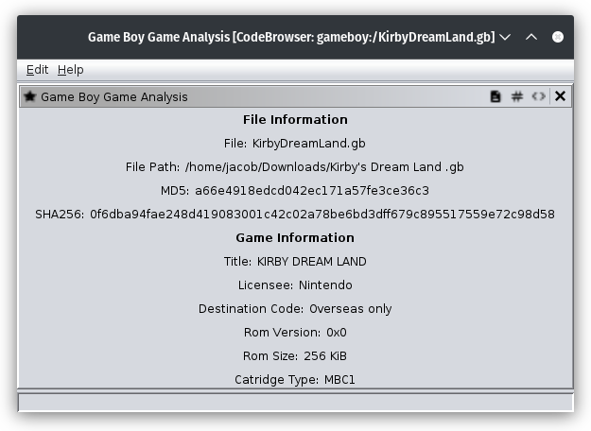
01
07
12
KIRBY’S DREAM LAND

Slide 54
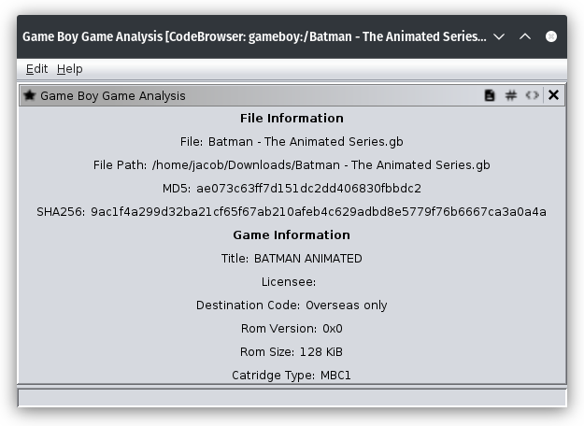
01
07
12
BATMAN: TAS

Slide 55
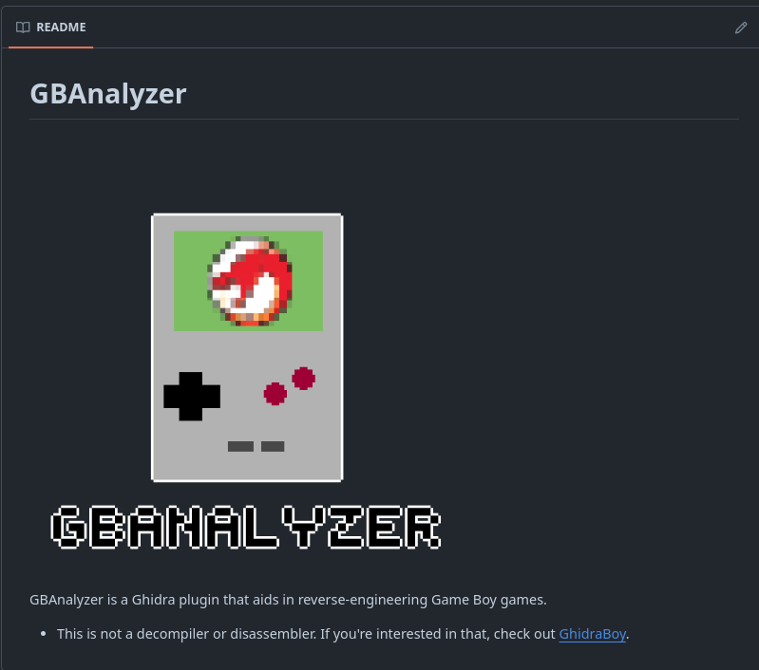
01
07
12
FULL SOURCE CODE?
Available on GitHub!
latonis/GBanalyzer

Slide 56

01
07
12
./UTILS
latonis/GBanalyzer

Slide 57
Back to Agenda Page
ADVANCED USE CASE

Slide 58



VTgrepGhidra
This plugin integrates functionality from VirusTotal web services into the GHIDRA's user interface.
ADVANCED USAGE PLUGINS
GhidraLookup
The GhidraLookup plugin helps users lookup documentation of WinAPI functions.
There’s a lot of great use cases and examples in the open-source land!

Slide 59

01
07
12
LINKS!
Available on GitHub!
latonis/GBanalyzer

Slide 60
0x00

